Slide 1
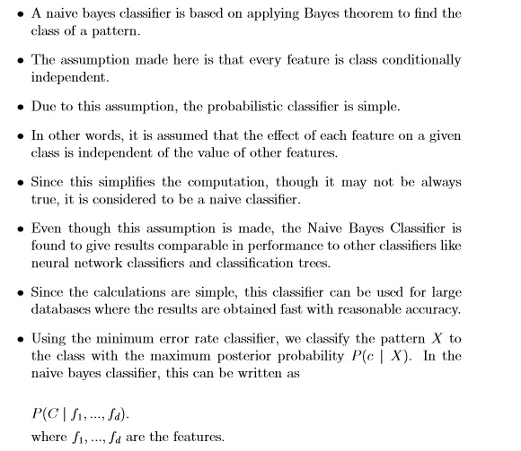
Naive Bayes Classiﬁer

Slide 2
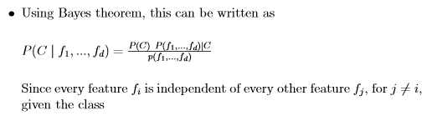
Naive Bayes Classiﬁer

Slide 3
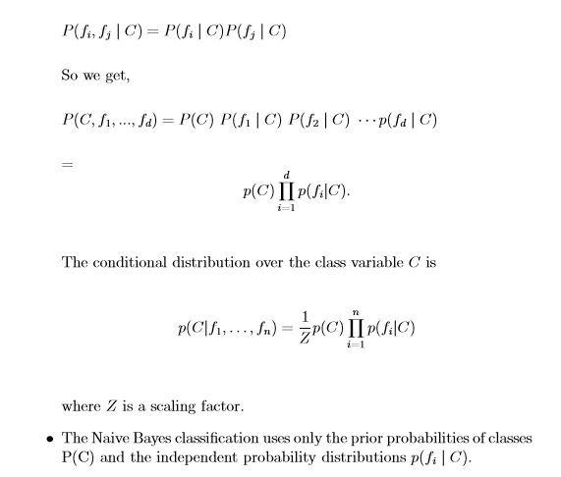
Naive Bayes Classiﬁer

Slide 4
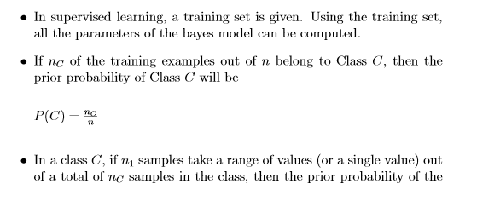
Parameter Estimation

Slide 5
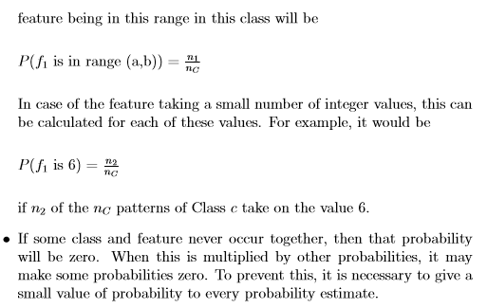
Parameter Estimation

Slide 6
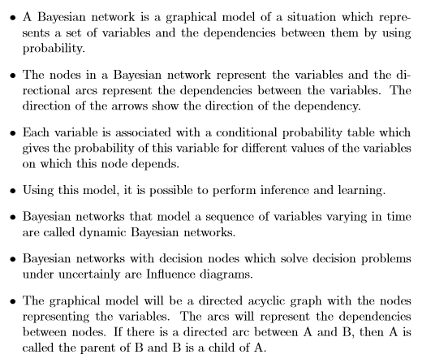
Bayesian Belief Network

Slide 7
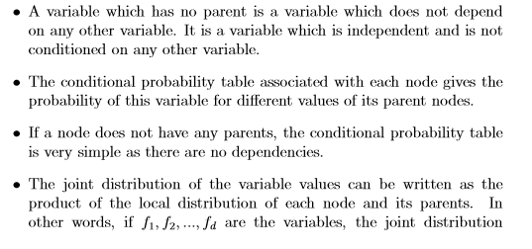
Bayesian Belief Network

Slide 8
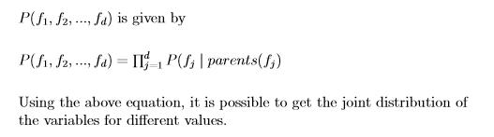
Bayesian Belief Network

Slide 9
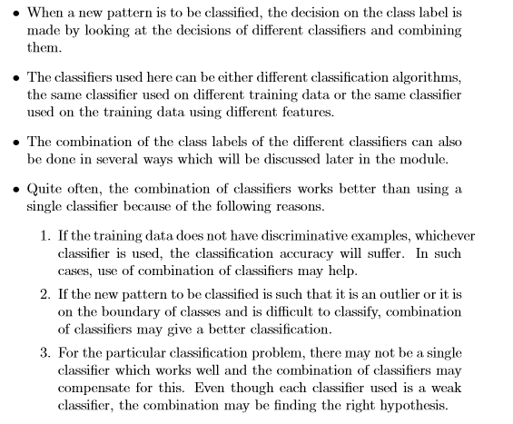
Combination of Classiﬁers

Slide 10
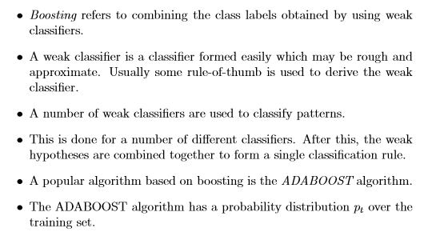
Combination of Classiﬁers:ADABOOST

Slide 11
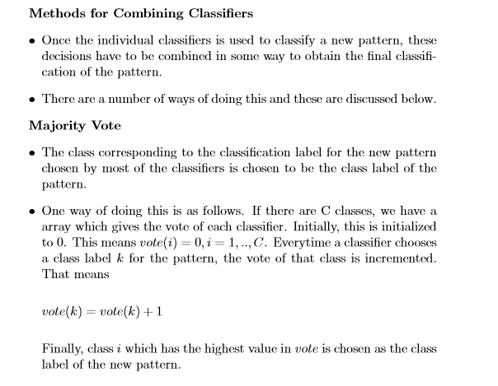
Combination of Classiﬁers

Slide 12
Methods of Constructing Ensemble of Classifiers
1. Subsampling the training set
2. Varying features used in the training set
3. Varying the classes by combining the classes and partitioning into two or more blocks.
4. Varying the classifier by using randomness
5. Some methods specific to certain type of classifiers.

Slide 13
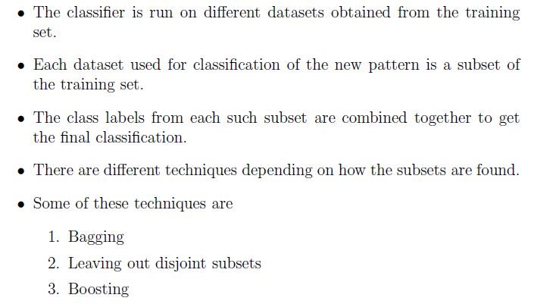
Subsampling the Training Set

Slide 14
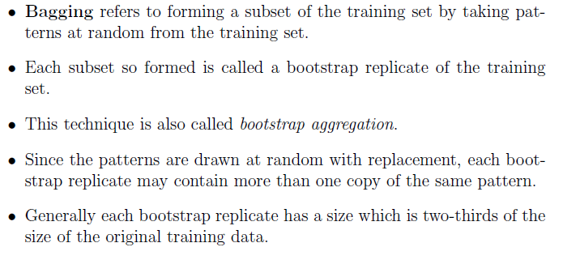
Bagging

Slide 15
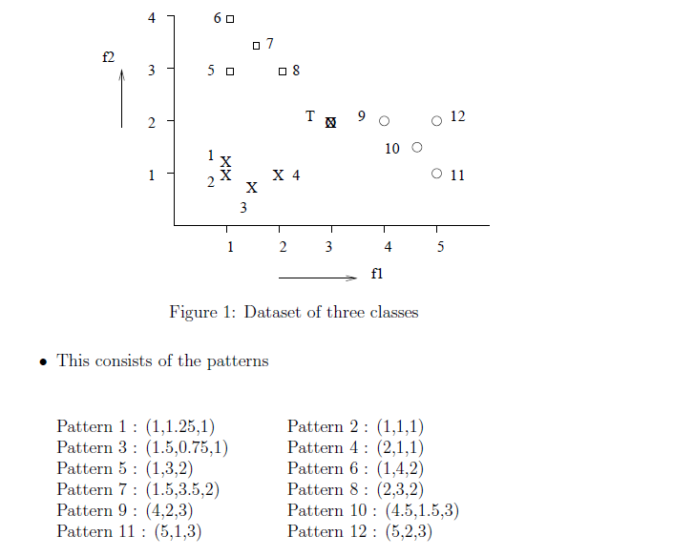
Ensemble Example

Slide 16
Ensemble Example
Each triplet consists of feature 1, feature 2 and the class label.
Let us have a test pattern at (3,2).
To generate a bootstrap replicate, let us draw at random two patterns from each class for each classifier.

Slide 17
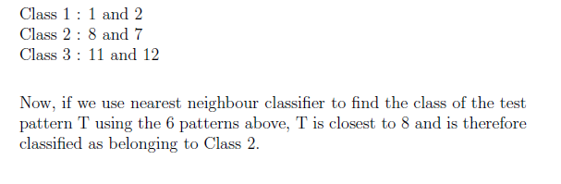
Ensemble Example
Classifier 1 :
Let the two random patterns drawn from each class be

Slide 18
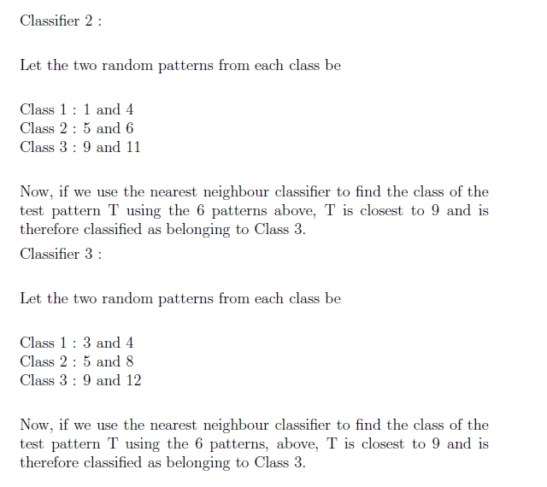
Ensemble Example

Slide 19
Ensemble Example
We now have to combine the class label obtained in the three classifiers to decide on the classification of T.
If we use majority vote, then T is given the class label 3.

